Slide 1
Quality Control in Clinical Microbiology Laboratory
Mohammad Rahbar (Ph.D)
Professor of clinical of Clinical Microbiology
Department of Microbiology, Iranian Reference Health Laboratory

Slide 2
Introduction
The clinician and the microbiologist must actively work together to maximize the clinical value of diagnostic microbiology testing. Unfortunately, the current trend to consolidate laboratory services and to move them off-site has made timely communication between laboratory personnel and patient care providers more difficult.

Slide 3
Introduction
In addition, these changes potentially increase the time between specimen collection and laboratory processing, compromising the specimen integrity and delaying the availability of critical test results. These changes, along with other cost-cutting measures, make it even more important that the infectious diseases physician and the microbiologist work together. The following expectations regarding the microbiologist’s and the clinician’s responsibilities should be recognized and addressed.

Slide 4
Microbiologist Responsibility
1- Provide an appropriate, comprehensive test menu that is responsive to physician
needs
2-Establish a relationship with an external laboratory for performance of infrequent, expensive, or sophisticated testing that cannot be performed on site.
3-Provide cut-off times for processing test requests and turnaround times for reporting results
4-Provide guidelines for specimen collection and transport

Slide 5
Microbiologist Responsibility
5-Maintain an effective computerized system for acknowledging receipt of specimens, testing in-progress, and reporting of results; immediate notification to the physician of critical results should be a component of an overall communication system
6-Periodic publication of antimicrobial susceptibility patterns for the most commonly isolated bacteria in the institution

Slide 6
Microbiologist Responsibility
7-Maintain a program of quality control that ensures the accuracy of all offered tests
8-Establish a laboratory that conforms to regulatory standards
9-A system of short-term storage of all specimens and long-term storage of important isolates should be established to facilitate additional testing if required

Slide 7
Clinician’s Responsibilities
1-Maintain knowledge of the laboratory test menu and specimen collection and transport guidelines
2-Alert the laboratory when a specific organism is sought (e.g., a fastidious or highly pathogenic organism)
2-Prioritize test requests when a limited quantity of specimen can be collected
Establish an open communication with the laboratory director when testing needs are not satisfied by the available test menu or special handling of a specimen is required

Slide 8
Quality Control
Continual monitoring of working practices, equipment & reagents so as to detecting & correcting defects
• => Maintains reliable / timely analytical
performance (result / outcome)
• => More patient-care-oriented approach

Slide 9
Stages of laboratory activities
The QC program must ensure optimum patient specimens and result integrity throughout the 3 stages processes:
1. Pre-analytical
2. Analytical
3. Post-analytical

Slide 10
Three stages of activities
Table 1- Three stages of activities that affect outcome of laboratory testing:
Stage | Activities
Preanalytical | Test ordering
 | Order transcription
 | Patient preparation
 | Specimen collection
 | Specimen identification
 | Specimen transport
Analytical | Sample testing (ID & ST)
Post-analytical | Result transcription
 | Result intrepretation
 | Action taken on basis of result
A quality outcome can be interrupted or destroyed at any point in the process.

Slide 11
Elements of QA
Specimen Collection and Transport
Standard Operating Procedure (SOP)
Personnel
Proficiency Testing
Performance checks
Reporting of Results

Slide 12
Continued..
Quality Control of Bacteriology:
Media
Stains
Reagents
Antisera
Antimicrobial Susceptibility Testing
Equipment's & instruments
Maintenance of QC Records
And etc

Slide 13
Standard Operation Procedures (SOP)
A SOP is a set of fixed instructions to carry out a routine activity or process. An example of a procedure would be a step-by-step description of how to perform a disk diffusion antimicrobial susceptibility test on a bacterial isolate. SOPs should have a consistent format and should be clear to all users so that the task being described is consistently performed.

Slide 14
Need of SOP s in laboratory work
Standard operating procedures in a microbiology laboratory are needed for following reasons:
To improve and maintain the quality of laboratory service to patients and identify problems associated with poor work performance;
· To provide laboratory staff with written instructions on how to perform test consistently to an "acceptable standard" in the laboratory;
To provide written standardized techniques for use in the training of laboratory personnel;
To facilitate the preparation of a list of essential reagents,
chemicals and equipment's;
To promote safe laboratory practice.

Slide 15
Important features of SOP
An individual SOPs must be:
Applicable and achievable in the laboratory in which they will be used;· Clearly written and easy to understand and follow; and · Kept up-to-date using appropriate technologies.

Slide 16
Important features of SOP
An individual SOPs must be:
Applicable and achievable in the laboratory in which they
will be used;
Clearly written and easy to understand and follow; and
Kept up-to-date using appropriate technologies.

Slide 17
Preparation of SOP
The procedure manual, a reference for standardization and
organization of all tests and functions, is the most important
document in the microbiology laboratory. It is written for new
inexperienced personnel but also serves as a reference for
experienced laboratory personnel.6 For that reason, SOPs
must be written and implemented by qualified experienced
laboratory officers, and followed exactly by all members of
staff. Each SOP must be given a title and identification
number, and be dated and signed by an authorized person.

Slide 18
Types of SOP
Standard operating procedures can be described under two
broad headlines:
One of them is 'standard procedure for general laboratory practices' which include: (a) request form, (b) collection and transportation of clinical specimens, (c) specimen acceptability and criteria for rejection, (d) procedure for processing specimens, (e) systematic descriptions of the tests performed, (f )antimicrobial susceptibility testing, (g) safety in laboratory and (h)quality assurance.

Slide 19
Stages of SOP
Total activities performed by laboratory personnel in order to provide accurate diagnosis from a clinical specimen can be divided into three stages. These are :
Pre-Analytical stage- primarily deals with the general concepts for specimen collection and handling
Analytical stage- deals with testing the specimens, .
Post-Analytical stage- comprises of reporting and interpreting test results.

Slide 20
Specimen Selection ,collection and transport
A variety of pathogens are usually considered, which increases the types of specimens that must be collected and the number of tests ordered. Although this may not pose a problem if the quantity of specimen is sufficient (e.g., blood, urine, stool, expectorated sputum), this can present a significant problem if the quantity is limited or the specimen difficult to obtain (e.g., aspirated fluids, tissue biopsy).

Slide 21
Continue…
Thus, the physician has the responsibility to consider carefully potential pathogens and the diagnostic tests that should be ordered. The physician also has the responsibility to ensure specimens representative of the site of infection are collected in the appropriate container and transported to the laboratory in a timely fashion.

Slide 22
Continue…
Delays while specimens remain in the patient care area adversely affect diagnostic testing. The microbiologist has the responsibility to provide appropriate, readily available instructions and materials for collection and transport of the specimens.

Slide 23
Continue…
Selection of the appropriate specimens depends on multiple factors.
If the diagnostic test is isolation of the organism in culture, then the
specimen must contain viable organisms; in addition, care should be
taken to avoid organisms that may either suppress or overgrow the
pathogen or confound the interpretation of the culture

Slide 24
Continue…
Ideally, the specimens should be collected before administration of antimicrobials. An adequate volume of specimen should be collected to maximize recovery of the pathogen, and an adequate number of specimens should be collected if the organism is transiently present (i.e., blood cultures for detection of bacteremia or fungemia)

Slide 25
Continue…
Microscopy is a rapid but typically insensitive and nonspecific method for detection of pathogens. Thus, if the quantity of specimen is limited, the value of microscopy must be balanced with the need for other diagnostic tests. If microscopy is the primary diagnostic test (e.g., examination of peripheral blood smears for plasmodia, Babesia, Borrelia), then multiple specimens may need to be examined by using specialized stains or microscopy techniques.

Slide 26
Continue…
Selection of the appropriate specimen for detection of microbial antigens is determined by the suspected pathogen. For example, cerebrospinal fluid (CSF) would be appropriate for diagnosis of cryptococcal meningitis, but both CSF and urine should be collected for diagnosis of pneumococcal meningitis. Likewise, the optimum specimens for diagnosis of Legionella pneumonia are bronchial lavage for culture and urine for antigen testing

Slide 27
Continue…
Serologic tests are useful if the collection of blood is properly timed to coincide with the peak level of antibodies or to demonstrate a significant rise in antibodies. Because these levels can vary for different pathogens, collections of samples should be coordinated carefully to optimize their usefulness and not as an afterthought when confronted with initial negative tests.

Slide 28
Continue…
Transport of specimens to the microbiology laboratory must be done in a timely fashion, which is particularly important in the handling of urgent requests. The laboratory should determine in what manner and how often specimens should be delivered and should periodically monitor this process to make sure that delivery to the laboratory is occurring as expected.

Slide 29
Continue…
It is important to include, with the time required to transport a specimen to the laboratory, the delays between collection of the specimen and shipment to the laboratory and the time between receipt of the specimen in the laboratory and laboratory processing. Efforts to minimize transit time (e.g., use of pneumatic tube systems) are wasted if there are significant delays after collection or receipt in the laboratory.

Slide 30
Continue…
The physician has the responsibility to minimize the former and the microbiologist the latter. These transit times should be monitored systematically as part of a diagnostic quality assurance program. It is also important to time the collection and transport of specimens to ensure they arrive in the laboratory before an established cutoff time for tests that are performed once per day or less often.

Slide 31
Quality of the specimen
Specimen
Microbiology laboratory
Quality Outcome/ clinical result
Health care value of the information provided by clinical microbiology lab is being significantly compromised by inappropriate specimens

Slide 32
Quality of the specimen
Inappropriate specimens:
Submission of contaminated specimens
Delay in specimen delivery
Viral culture without transport media
Collection of specimens from inappropriate body sites
• =>Collection of microbiology specimens is generally not under direct control of lab.

Slide 33
Rejection criteria for improper samples:
Criteria should be developed by a laboratory on the basis of which the processing may not be done by the laboratory. The following are some examples of unacceptable specimens:
1-Missing or inadequate identification;
2-Insufficient quantity;
3-The specimen has been transported at the improper temperature in improper medium (e.g., specimen for anaerobic bacteria submitted in aerobic transports

Slide 34
Rejection criteria for improper samples
4- Specimen collected in an inappropriate container;
5- Contamination suspected;
6- Unknown time delay;
7- Leaking container or open mouthed container;
6- Specimen is dried up;· Saliva instead of sputum; and · Inappropriate request, e.g., Folley's catheter tip, oral swab, etc.

Slide 35
Rejection criteria for improper samples
It is an important rule to talk to the requesting physician before discarding unacceptable specimens. In some cases, such as mislabeling of a specimen or requisition, the person who collected the specimen or requisition can come to the laboratory and correct the problem. Correction of a mislabeled specimen or requisition should not be done over the telephone.

Slide 36
Personnel
Active participation by everyone working in the system is required to meet quality standards & continuously improve performance
Assign responsibility / duties

Slide 37
Personnel
Personnel | Function
Quality Improve ment Executive Committee | -Reviews and approves policies and procedures required to achieve quality improvement goals - Fosters interdisciplinary communication, facilitates problem solving and documents results of QA activities.
Microbiolog- ist | -Participates in monitoring and evaluating laboratory services. Provides recommendations for improving services; for example; The microbiologist must make many clinical decisions regarding collection and transmission of specimens. The extent of his/her role in the interpretation and utilization of microbiological information must also be considered
Technologists & Technician | Implements procedures and manages data in accordance with QA goals. Provides recommendations to director for improving services

Slide 38
Personnel
The employee’s personnel records contain:
Qualification & experience
The tasks & procedures that the employee is authorized to perform (dates of received training & competence tests)
Continuing education activities (attend some training program or workshop)
Regular meeting to keep staff informed of changes & to solicit their suggestion for improving the lab. service

Slide 39
Culture Media
Definitions of culture media
Types of culture media
Significant culture media used within Microbiology QC
Approaches to the QC testing of media
Selecting microorganisms
Supplier audits
Notes:
The formulations of many microbiological media are described in the Pharmacopoeias but with the international harmonisation activities a lot of changes took place.
Culture media are of essential importance for the microbiological quality control. Or, put it in another way, without culture media there would be no microbiological QC.
Culture media are used for Microbiological Monitoring Media Fills Enumeration Tests Test of Specified Microorganisms Sterility Test Microbial Identification

Slide 40
Definition of Culture medium
Microbiological culture medium
A substance which encourages the growth, support and survival of micro-organisms.
Contains nutrients, growth promoting factors, energy sources, buffer salts, minerals, metals and gelling agents (for solid media).
Notes:
Around since C19th

Slide 41
Introduction
Definitions of culture media
Types of culture media
Significant culture media used within Microbiology QC
Approaches to the QC testing of media
Selecting microorganisms
Supplier audits
Notes:
The formulations of many microbiological media are described in the Pharmacopoeias but with the international harmonisation activities a lot of changes took place.
Culture media are of essential importance for the microbiological quality control. Or, put it in another way, without culture media there would be no microbiological QC.
Culture media are used for Microbiological Monitoring Media Fills Enumeration Tests Test of Specified Microorganisms Sterility Test Microbial Identification

Slide 42
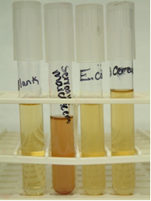
Culture Media: Types
Culture media is divided into:
Liquid culture media. This is commonly called ‘broth’.eg TSB
Nutrient broth and
Notes:
e.g. TSB

Slide 43
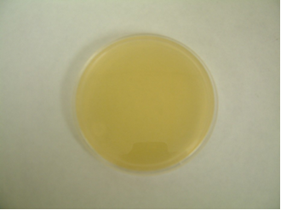
Culture Media: Types
Solid and semi-solid culture media.
Contains a solidifying material which may be agar-agar or gelatine or some other analogous substance.
This media is commonly called ‘agar’, irrespective of the type of solidifying agent used.
Notes:
E.g. TSA
Agar-aagr = red seaweed

Slide 44
Culture Media: Types
Further divisions:
Growth media
Transport media (e.g. Carry Blair .Stuart …)
Preservation media
Resuscitation media
Enrichment media (e.g. blood agar ,chacholate agar)
Selective growth media (e.g. MacConkey agar)
Differential media (with some sort of indicator, typically a dye)
Minimal media (for ‘wildtypes’)
Some of the above media may have multiple uses.e.g. Blood agar

Slide 45
Culture media preparation
Choice of media, selection of brand and formulation
Calculation and weighing of dehydrated media
Mixing with water and heating
Sterilization
Fine-tuning: Adding supplements, pH verification
Dispensing of prepared culture media
Packing and storage
Sterility check

Slide 46
Quality Assurance
Quality Assurance
Those processes before, during and after the manufacture of medical microbiological culture media that verify the adequacy of the media for its intended purpose.
Quality Control:
The final inspection and testing of the finished product to ensure its compliance with predetermined performance criteria

Slide 47
Quality control requirements for culture media preparation
✓ Should be based on a pragmatic, risk-based approach
✓ Perform QC for each newly prepared batch
✓ Quarantine newly prepared and dispensed media until they pass Q
pH verification.

Slide 48
Visual inspection
✓ Cracked or damaged plates
✓ Agar detached from the plates
✓ Frozen or melted agar
✓ Unequal filling of the plates
✓ Insufficient amount of agar (<3 mm)
(Note: For Muellere Hinton agar, the agar depth should be 4 ± 0.5 mm)

Slide 49
Visual inspection
✓ Haemolysis of blood-containing media
✓ Changes in the expected colour of the media
✓ Excessive bubbles or rough surfaces
✓ Excessive moisture or dehydration
✓ Obvious contamination

Slide 50
Visual inspection
✓ Presence of precipitates
✓ Integrity of the packaging
✓ Presence of broken or cracked Petri plates or tubes
✓ Presence of leakage from the Petri plates or tubes
✓ Accuracy of the labelling

Slide 51
Sterility check
✓ 48 h incubation at 35±2C (varying from 24 h to 5 days depending on the
reference)
✓ Batch with <100 units: 2% sample; batch with >100 units: ten random units
✓ In case of contamination, reject the batch and prepare a new one
✓ Do not re-use the plates used for sterility check
✓ Note that an additional visual check should always be done right before use

Slide 52
Performance check:
✓ Use QC organisms:
Choose appropriate QC organisms based on standards, guidelines or
manufacturer's instructions
Type culture collection organisms (e.g. ATCC) are recommended but previously
characterized clinical organisms or EQA strains shown to be phenotypically
stable (documentation required) are also accepted
QC organisms should be correctly maintained and stored (refer to CLSI M22-A3

Slide 53
Troubleshooting: overview of the most common errors and possible causes
✓ Humidity too high during storage
✓ Container left open for too long
✓ Container not tightly closed after opening
✓ Dehydrated culture medium beyond shelf life

Slide 54
Wrong pH
✓ pH meter not calibrated
✓ pH verification done on too hot medium (generally to be done at 25C)
✓ Overheating: excessive sterilization, heterogeneous mixing, medium kept at 50C for too long, repeated re-melting or at too high temperature
✓ Use of poor-quality water or container
✓ Use of chemically contaminated containers
✓ Incomplete dissolution/mixture of medium
✓ Dehydrated medium stored incorrectly (e.g. not tightly closed) or beyond shelf life

Slide 55
Incomplete solubility
✓ Use of inadequate water
✓ Inadequate heating/inadequate timing for dissolution
✓ Insufficient soaking or incomplete mixing
✓ Flask too small to allow adequate mixing and/or convection

Slide 56
Darkening, caramelization
✓ Overheating: excessive sterilization, heterogeneous mixing, medium kept at 50C for too long,
repeated re-melting or at too high temperature

Slide 57
Incomplete gelling or soft agar
Incorrect proportions of product to water: error in weighing or over-dilution
✓ Agar not properly dissolved: poor mixing, prolonged storage at 50C
✓ Overheating of culture medium, possibly at low pH
✓ Repeated re-melting causing overheating

Slide 58
Turbidity, precipitation
Poor quality of dehydrated media
✓ Use of poor quality of water or container
✓ Overheating: excessive sterilization, heterogeneous mixing, medium kept at 50C for too long, repeated
re-melting or at too high temperature
✓ Wrong pH
✓ Incomplete dissolution/mixture of medium
✓ Loss of water of the prepared culture medium due to evaporation

Slide 59
Poor growth or loss of differential properties
✓ Incorrect or improperly maintained QC organisms used
✓ Overheating: excessive sterilization, heterogeneous mixing, medium kept at 50C for too long, repeated
re-melting or at too high temperature of medium
✓ incomplete dissolution/mixture
✓ Inhibitory substances in water, container or inoculum
✓ Wrong pH

Slide 62
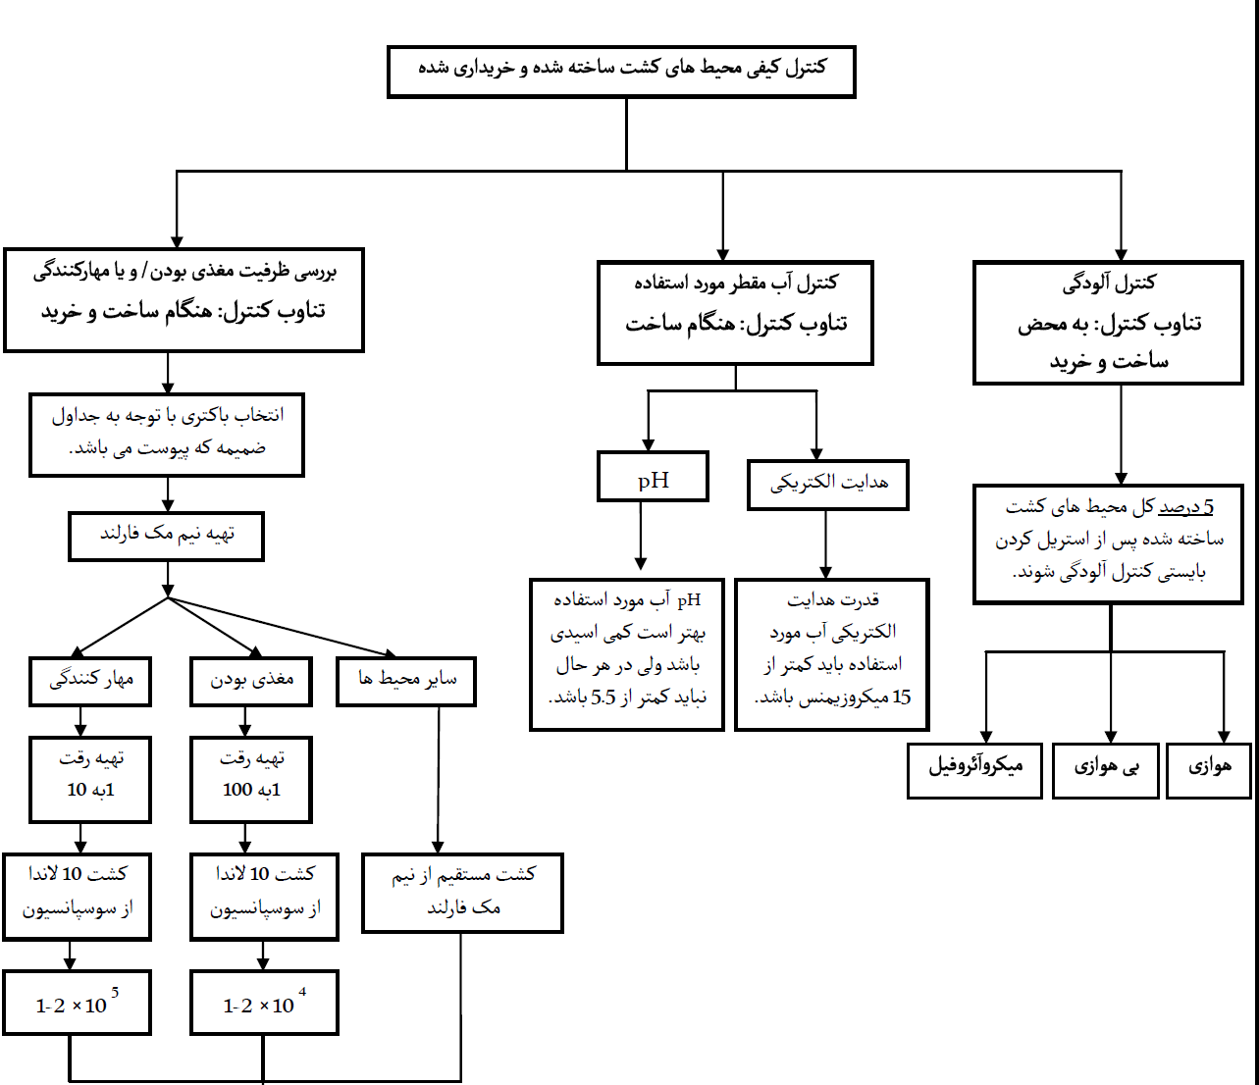

Slide 63
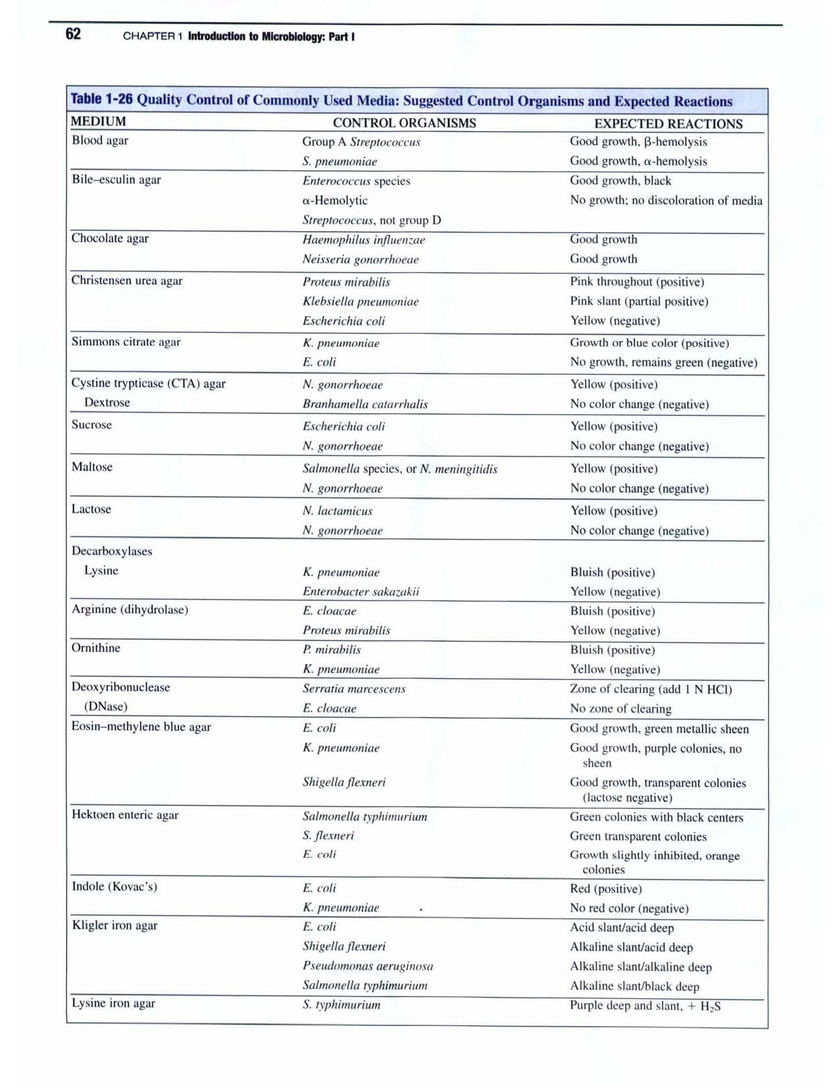

Slide 64
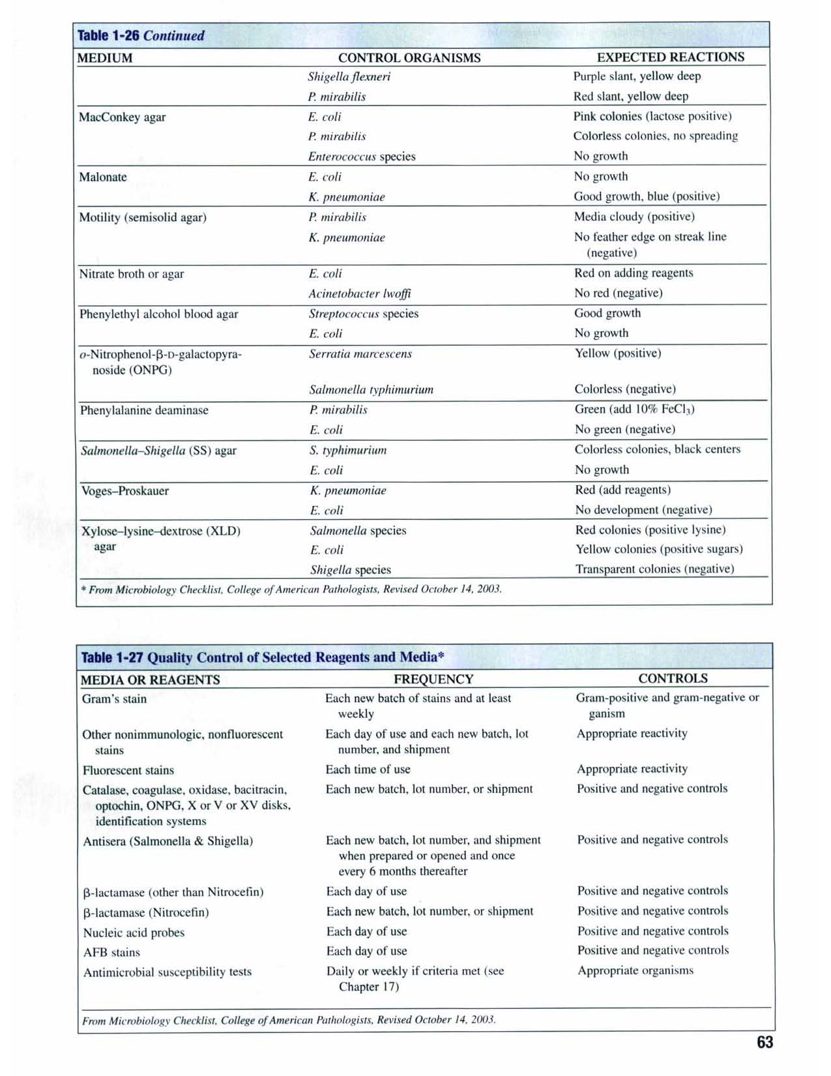

Slide 66
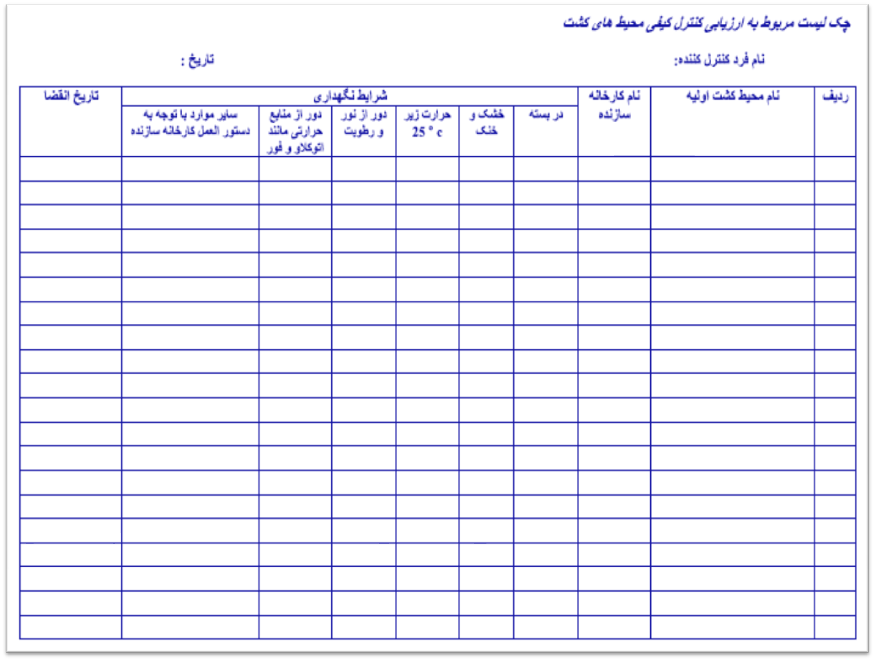
Continued..

Slide 67


Slide 68


Slide 69
Use of Quality Control Strains
Control strains should be cultures that exhibit typical microscopic, macroscopic and biochemical characteristics of the species, and must be cultures that have been verified and validated and whose lineage is documented .

Slide 70
Quality Control Strains
The cultures used for Quality Control Testing of media have been selected because of growth attributes or biochemical characteristics. Over an extended period, it is expected that these cultures will be consistent in their phenotypic properties. Cultures when received from a culture collection or other recognized (authorised) source should be preserved.

Slide 71
Use of Quality Control Strains
It is desirable to minimize the number of transfers between the master culture and the working culture such that there is limited population or genetic change. The most effective system for managing the culture collection is the hierarchical or tiered system that includes Master, Stock and Working cultures.

Slide 72
Use of Quality Control Strains
When a culture is first received by a laboratory it should be activated and tested for purity and identity. If pure, growth from this plate is used to prepare freeze dried ampoules, frozen glycerol broths or beads, or some equivalent system which minimises change but allows long term viability of the micro-organism.

Slide 73
Use of Quality Control Strains
In addition to the purity check, and at the same time of preservation, the identity of the culture should be verified including the particular characteristics utilized for media growth performance checks. The preserved culture generated by this process is termed MASTER culture and should not be accessed frequently.

Slide 74
External Quality Assessment (EQA)
The term external quality assessment (EQA) is used to describe a method that allows for comparison of a laboratory’s testing to a source outside the laboratory.
This comparison can be made to the performance of a peer group of laboratories or to the performance of a reference laboratory.
The term EQA is sometimes used interchangeably with proficiency testing;however, EQA can also be carried out using other processes.

Slide 75
Types of EQA
Several EQA methods or processes are commonly used. These include:
1. Proficiency testing external provider sends unknown samples for testing to a set of laboratories, and the results of all laboratories are analyzed, compared, and reported to the laboratories.
2. Rechecking or retesting slides that have been read are rechecked by a reference laboratory; samples that have been analyzed are retested, allowing for inter-laboratory comparison

Slide 76
EQA benefit
Participation in an external quality assessment program provides valuable data and information which:
1- Allows comparison of performance and results among different test sites
2- provides early warning for systematic problems associated with kits or operations.
3-provides objective evidence of testing quality;
4-Indicates areas that need improvement;
5- Identifies training needs.

Slide 77
EQA benefit
EQA helps to assure customers, such as physicians, patients, and health authorities, that the laboratory can produce reliable results. Individual laboratories can use EQA to identify problems in laboratory practices, allowing for appropriate corrective action. EQA articipation will help to evaluate reliability of methods, materials, and equipment, and to evaluate and monitor training impact.For laboratories performing public health-related testing, EQA can help to assure that results from different laboratories during surveillance activities are comparable

Slide 78
EQA benefit
EQA participation is usually required for accreditation. Also, EQA participation creates a network for communication, and can be a good tool for enhancing notational
laboratory network. Samples received for EQA testing, as well as the information shared by the EQA provider, are useful for conducting continuing education activities.

Slide 79
Principal characteristics of an EQA scheme
EQA programs vary but principal characteristics include the following:
1-EQA programs can either be free-of-charge or require a fee. Free EQA programs include those offered by a manufacturer to ensure equipment is working correctly and those organized by a regional or national program for quality improvement

Slide 80
Principal characteristics of an EQA scheme
Some EQA programs are obligatory, either required by an accrediting body or by law. Others are voluntary, and the quality manager may choose to voluntarily participate in an EQA program in order to achieve improvement in the quality of the laboratory’s performance.
The EQA program can be organized at different levels: regional, national, or international.

Slide 81
Continue…
Individual laboratory results are kept confidential, and generally are only known by the participating laboratory and the EQA provider. A summary is generally provided and allows comparison to the overall group
Some EQA schemes may address a single disease, for example the EQA program for tuberculosis. Others may address many kinds of laboratory tests, looking at the overall testing performance for microbiology. An example of this multi-disease or test program is the national microbiology EQA in France, which is obligatory.

Slide 82
Rechecking process
This method is most commonly used for acid-fast smears; the slides that were read in the original laboratory are “rechecked” in a central or reference laboratory. This allows for the accuracy of the original report to be evaluated, and also allows for the assessment of the quality of the slide preparation and staining.

Slide 83
Rechecking process
The following principles are important when performing recheck procedures.
1- The slides for re-examination must be collected randomly. Every effort
should be made to avoid systematic sampling bias.
2- Rechecking must be based upon statistical considerations. A common
method is for the central laboratory to recheck 10% of negative and 100% of positive slides.
3- When discrepancies occur, there should be procedures in place to resolve
them.
4- The outcome of rechecking must be analyzed for effective and timely
feedback.

Slide 84
On-site evaluation
A periodic visit by evaluators for on-site laboratory assessment is a type of EQA that has been used when other methods of EQA are not feasible or effective. Again, this method has most frequently been employed for assessment of sites performing AFB smears, and those performing HIV rapid testing.

Slide 85
On-site evaluation can be a valuable tool to
1-obtain a realistic picture of laboratory practices by observing the
laboratory under routine conditions in order to check that it is meeting
quality requirement
2- provide information for internal process improvement; measure gaps or deficiencies—learn “where we are”; assist the laboratory in collecting information for planning and implementation of training, monitoring, and corrective actions.
On-site evaluation for the purpose of EQA may be conducted by a central reference laboratory or other health authorities. On-site evaluation can be used together with retesting and rechecking schemes to provide more

Slide 86
Managing EQA in the Laboratory
Participation in EQA
All laboratories should participate in EQA challenges, and this should include EQA for all testing procedures performed in the laboratory, if possible. The benefits of this participation are considerable, and EQA provides the only means available to a laboratory to ensure that its performance is comparable to that of other laboratories

Slide 87
Managing EQA in the Laboratory
• For laboratories that are accredited, or that plan to seek accreditation, EQA
participation is essential. ISO 15189 addresses EQA requirements for laboratories
as follows.
• There is a requirement that the laboratory participate in interlaboratory
comparisons.•
Where an established EQA scheme is not available, an alternate EQA mechanism will have to be considered for interlaboratory comparison such as exchange of samples with other laboratories.
The laboratory management shall monitor the results of EQA and participate in the implementation of corrective action

Slide 88
When participating in EQA programs, the laboratory needs to develop a process
for the management of the process. A primary objective is to assure that all EQA
samples are treated in the same manner as other samples tested.
Procedures should be developed.
• Handling of samples—These will need to be logged, processed properly, and
stored as needed for future use.
• Analyses of samples—Consider whether EQA samples can be tested so that
staff do not recognize them as different from patient samples–blinded testing.

Slide 89
• Appropriate record keeping—Records of all EQA testing reporting should be
maintained over a period of time, so that performance improvement can be
measured.
• Investigation of any deficiencies—For any challenges where performance is
not acceptable.
• Taking corrective action when performance is not acceptable—The purpose of
EQA is to allow for detection of problems in the laboratory, and to, therefore,
provide an opportunity for improvement.
• Communication of outcomes to all laboratory staff and to management.

Slide 90
External Quality Assessment problems
Pre The sample may have been compromised during preparation, shipping, or after receipt in the laboratory by improper storage or handling. The sample may have been processed or labeled improperly in the laboratory.-examination

Slide 91
Examination
Pre-examination
The sample may have been compromised during preparation, shipping, or after receipt in the laboratory by improper storage or handling. • The sample may have been processed or labeled improperly in the laboratory

Slide 92
Examination
• The EQA challenge materials may exhibit a matrix effect in the examination system used by the participating laboratory.•
Possible sources of analytical problems include reagents, instruments, test methods, calibrations, and calculations. Analytical problems should be investigated to determine whether error is random or systemic.
• Competency of staff will need to be considered and evaluated.

Slide 93
Examination
The EQA challenge materials may exhibit a matrix effect in the examination system used by the participating laboratory.• Possible sources of analytical problems include reagents, instruments, test
methods, calibrations, and calculations. Analytical problems should be investigated to determine whether error is random or systemic.
• Competency of staff will need to be considered and evaluated

Slide 94
Post-examination
The report format can be confusing.
• Interpretation of results can be incorrect.
• Clerical or transcription errors can be sources of error

Slide 95
Guidelines for Susceptibility testing
1-Clinical laboratory Standards Institutes ( CLSI) Formerly CLSI 2006
2- European Committee on Antimicrobial Susceptibility Testing – EUCAST
In Our country nearly all microbiology Laboratories use CLSI guidelines.

Slide 96
Critical Challenges in AST
Pure isolate
Culture media: Muller-Hinton
Reagents: disks
Size of the inoculums
Incubation condition
Control with reference strains
Reading inhibition diameters (accurate measurement)
Knowledge of staff

Slide 97
Quality control strains
Each QC strain should be obtained from a recognized source (eg, ATCC®). All CLSI-recommended QC strains appropriate for the antimicrobial agent and reference method should be evaluated and produce results within the expected ranges listed in M100 that were established according to the procedures described in CLSI document

Slide 98
Quality Control Reference Strains
• Escherichia coli ATCC® 25922;
• Escherichia coli ATCC® 35218; / B-ihibitor.co
• Haemophilus influenzae ATCC® 49247;
• Haemophilus influenzae ATCC® 49766;
• Klebsiella pneumoniae ATCC® 700603; /ESBL
• Neisseria gonorrhoeae ATCC® 49226;
• Pseudomonas aeruginosa ATCC® 27853;
• Staphylococcus aureus ATCC® 25923;
• Streptococcus pneumoniae ATCC® 49619.

Slide 99
Quality Control Reference Strains
Enterococcus faecalis ATCC® 29212 (or alternatively
E. faecalis ATCC® 33186) is recommended for monitoring Mueller-Hinton agar for unacceptable levels of thymidine when trimethoprim or sulfonamides are tested.
E.faecalis ATCC® 29212 is also used for control of high-content aminoglycoside disks
H. influenzae ATCC® 49247 is an ampicillin-resistant, B-lactamase-negative organism.
H. influenzae ATCC® 49766 is an ampicillin-susceptible organism that is more reproducible than H. influenzae ATCC® 49247 for controlling selected B-lactams.

Slide 100
Storing Quality Control Strains
Cultures may be maintained at -20 ºC or below (preferably at -60 ºC or below or in liquid nitrogen) in a suitable stabilizer (e.g., 50% fetal calf serum in broth, 10 to 15% glycerol in tryptic soy broth, defibrinated sheep blood, or skim milk), or in a freeze-dried state without significant risk of altering their antimicrobial susceptibility.

Slide 101
Storing Quality Control Strains
Working control cultures should be stored on tryptic soy agar (nonfastidious strains) or on enriched chocolate agar (fastidious strains) slants at 2 to 8 ºC and subcultured each week for no more than three successive weeks. New working cultures should be prepared at least monthly from frozen,freeze-dried, or commercial cultures.

Slide 102
The 15-Replicate (3 × 5 Day) Plan
Test three replicates of each applicable QC strain using individual inoculum preparations for five consecutive test days and document results.

Slide 103
The 15-Replicate (3 × 5 Day) Plan
Upon successful completion of the 15-replicate (3 × 5 day) plan, it is acceptable to go to weekly QC testing.
If completion of the 15-replicate (3 × 5 day) plan is unsuccessful, take corrective action as appropriate, and continue daily QC testing.

Slide 105
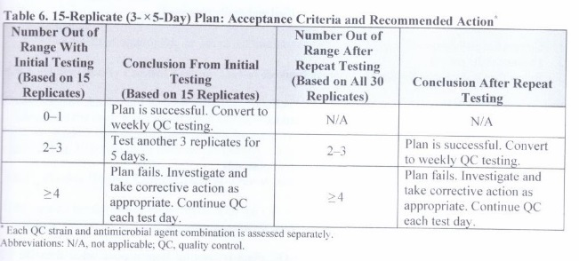

Slide 106
Implementing Weekly Quality Control Testing
Perform quality control testing once per week and
whenever any reagent component of the test (e.g., A new lot of agar or a new lot of disks from the Same or a different manufacturer) is changed.If any of the weekly quality control results is out Of the acceptable range, corrective action is required..

Slide 107
Out-of-Range Results With Quality Control Strains and Corrective Action
Out-of-range QC results can be categorized into those that are 1) random, 2) identifiable, or 3) system related.
QC ranges are established to include ≥ 95% of results obtained from routine testing of QC strains. A small number of (random) out-of-range QC results may be obtained even when the test method is performed correctly and materials are maintained according to recommended protocols. Such occurrences are due to chance.

Slide 108
Daily or Weekly Quality Control Testing – Out-of-Range Result Due to Identifiable Error
Out-of-range results with QC strains due to random or identifiable errors can usually be resolved by a single repeat of the QC test. However, out-of-range QC results that are due to a problem with the test system usually do not correct when the QC test is repeated and may indicate a serious problem that can adversely affect patient results. Every out-of-range QC result must be investigated

Slide 109
If the reason for an out-of-range result can be identified and easily corrected, correct the problem, document the reason, and retest the QC strain on the day the error is observed. If the repeated result is within range, no further corrective action is required

Slide 110
Identifiable reasons for the out-of-control results may include, but are not limited to:
QC strain
Use of the wrong QC strain
Improper storage
Inadequate maintenance (eg, use of the same F2 subculture for > 1 month)
Contamination
Nonviability
Changes in the organism (eg, mutation, loss of plasmid)

Slide 111
Testing process
Inoculum suspensions incorrectly prepared or adjusted
Inoculum prepared from a plate incubated for the incorrect length of time
Inoculum prepared from differential or selective media containing antimicrobial agents or other growth-inhibiting compounds

Slide 112
معرف | ارگانیسم کنترل | شماره ATCC | نتیجه مورد انتظار | دفعات انجام آزمایش QC
Bacitracin disk | Strep.pyogenes Strep. agalactiae | 19615 12386 | هاله عدم رشد (بزرگتر از 10mm) عدم هاله یا کمتر از 10mm | هر سری ساخت و سپس هر ۳ ماه
Coagulase (لام با آب مقطر و زیر ده ثانیه) | Staph.aureus Staph.epidermidis | 25923 12228 | مثبت (ایجاد لخته) منفی (عدم ایجاد لخته) | هر سری ساخت و سپس با هر بار آزمایش
Ferric chloride (10%) | Proteus vulgaris Escherichia coli | 33420 25922 | مثبت (سبز رنگ) منفی (بدون تغییر رنگ) | هر سری ساخت و سپس هر ۳ ماه
Methyl red | E. coli K. pneumoniae | 25922 13883 | مثبت (قرمز رنگ) منفی (بدون تغییر رنگ) | هر سری ساخت و سپس هر ۳ ماه
ONPG | E. coli Proteus mirabilis | 25922 29245 | مثبت (زرد رنگ) منفی (بدون تغییر رنگ) | هر سری ساخت و سپس هر ۳ ماه
Voges-Proskauer | Enterobacter cloacae E. coli | 13047 25922 | مثبت (قرمز رنگ) منفی (بدون تغییر رنگ) | هر سری ساخت و سپس هر ۳ ماه
Indole (Kovacs) | E. coli P. aeruginosa | 25922 27853 | مثبت (ارغوانی رنگ) منفی (بدون تغییر رنگ) | هر سری ساخت و سپس هر ۳ ماه
Optochin (در حضور CO2) | Strep. pneumoniae Strep. pyogenes | 6305 19615 | حساس مقاوم | هر سری ساخت و سپس هر ۳ ماه

Slide 113
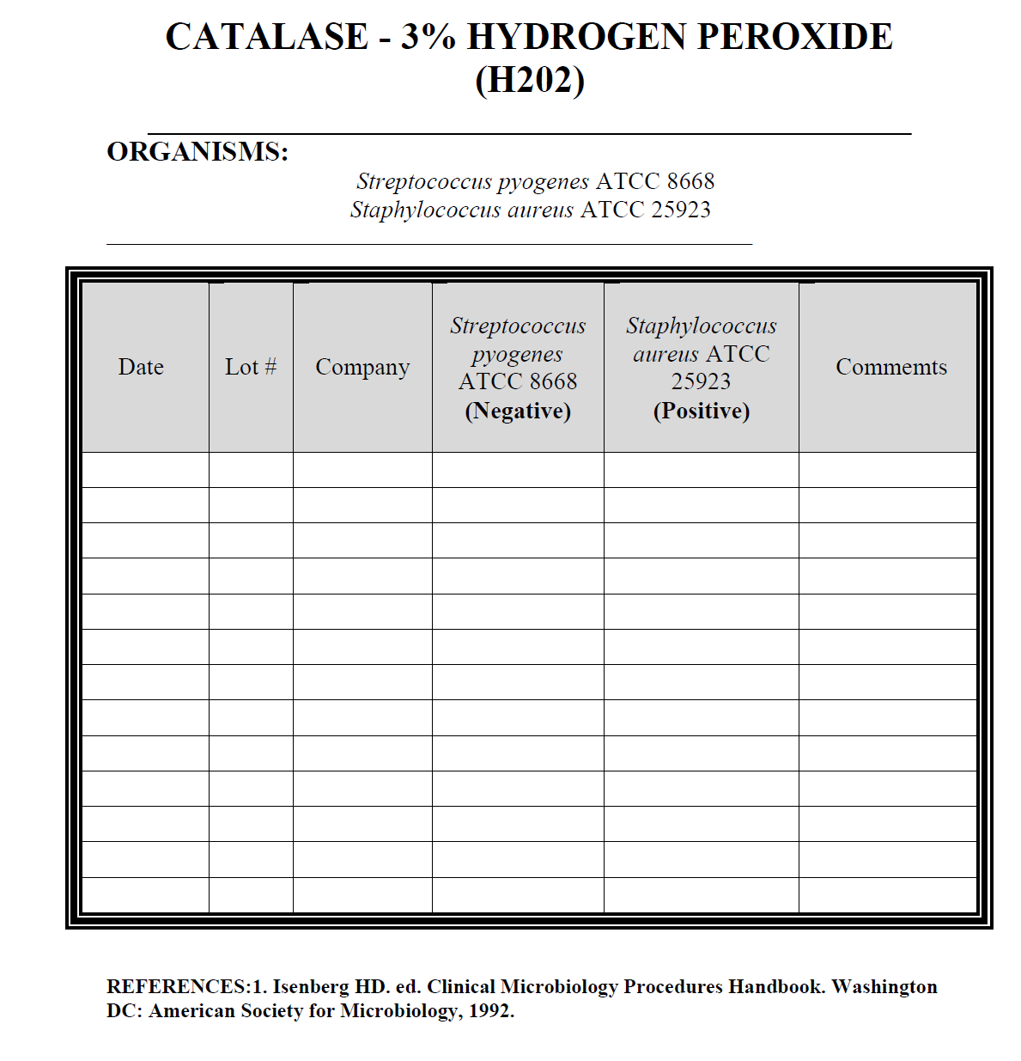

Slide 114
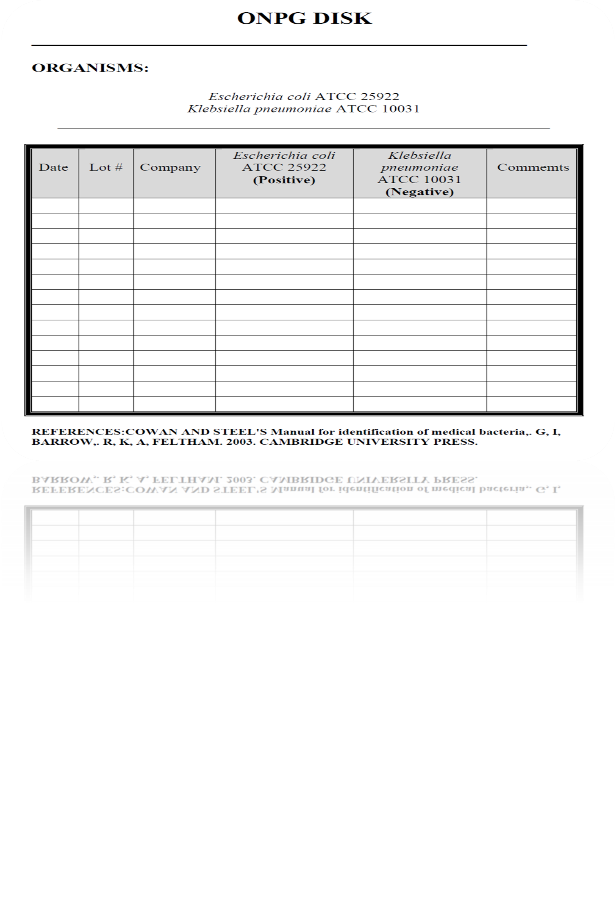

Slide 115
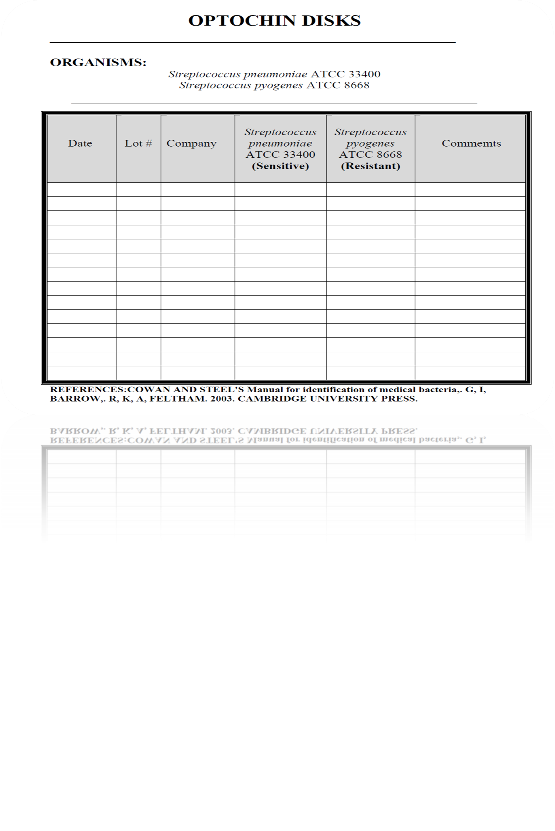

Slide 116
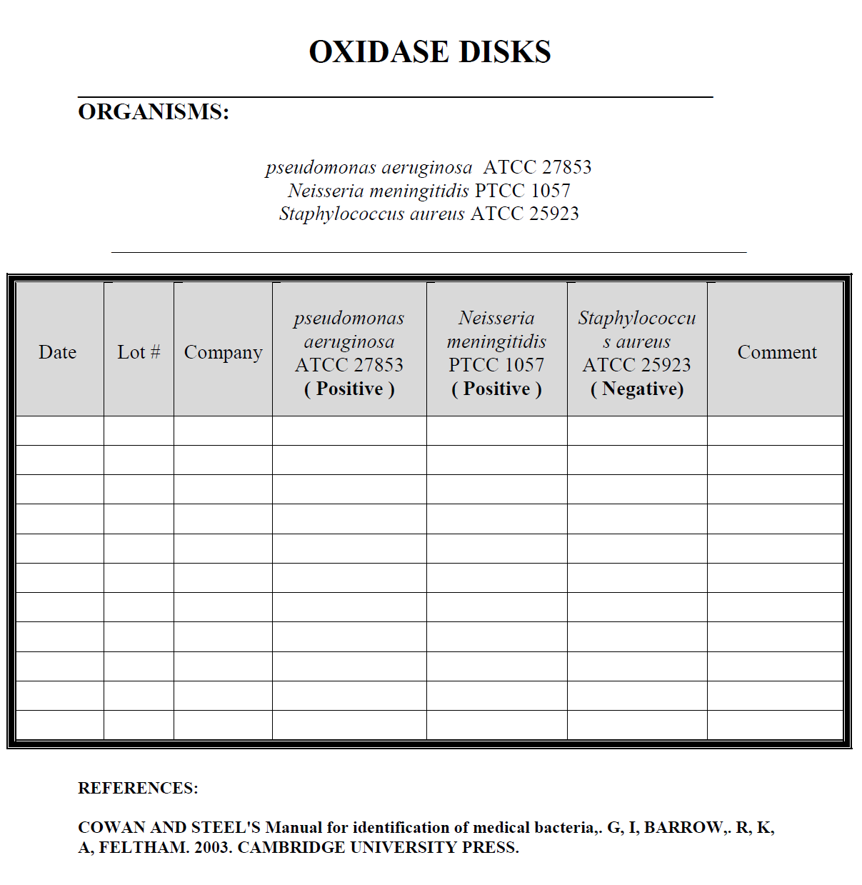

Slide 117
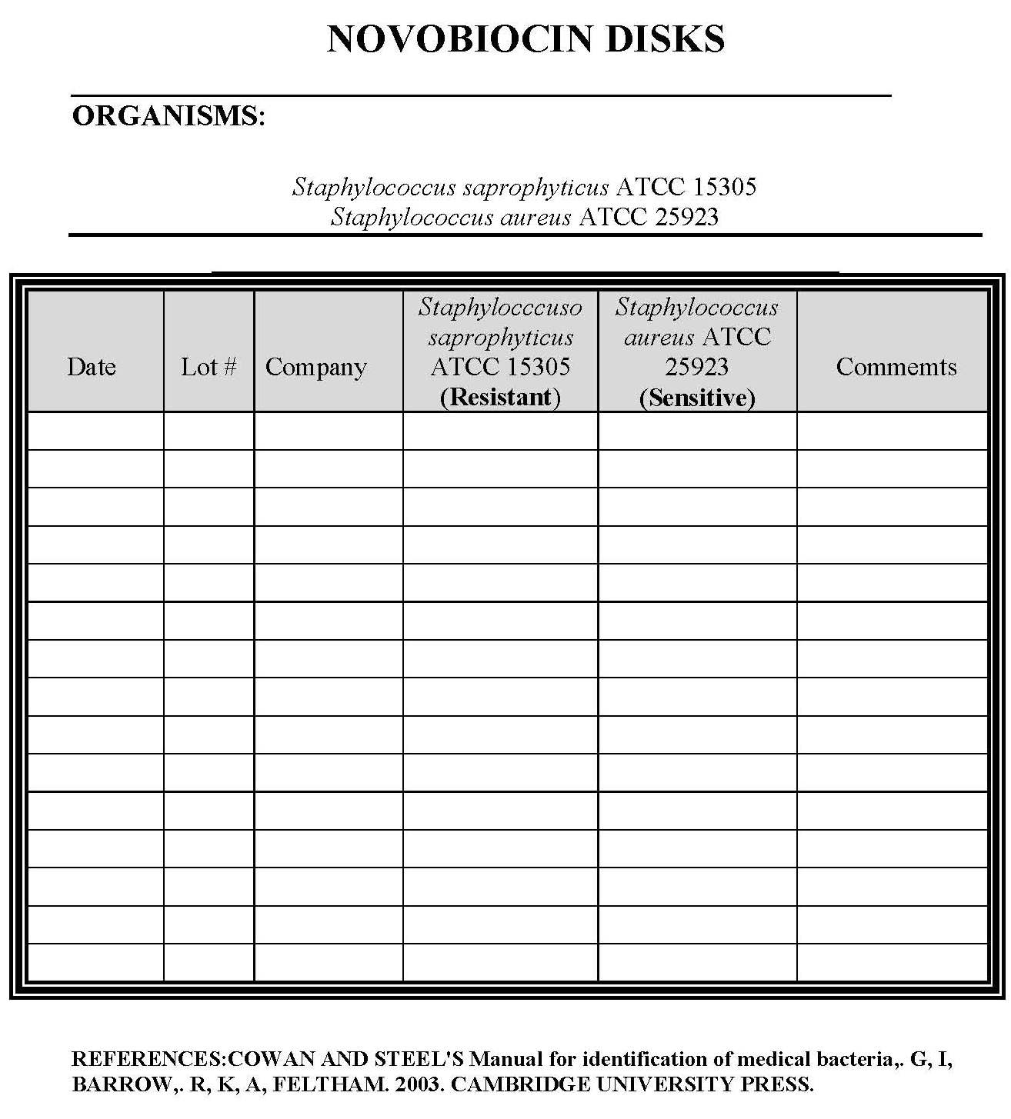
Reporting policy

Slide 118
Post analytical stage (Results Reporting)
The result of microbiological examination usually becomes available in stages on successive days. So, the SOP needs to include: (a) reporting and verifying test results, (b)interpreting test reports correctly, and (c) taking appropriate action when a result has serious implications for a patient or public health.

Slide 119
Wording of reports:
The aim of the clinical microbiologist is to provide clinicians and health officers with reports that are understandable, The laboratory should, therefore, have a carefully constructed policy for the wording of reports and all staff should adhere to the policy.

Slide 120
Reporting policy
The laboratory policy for reports should specify not only the wording of interpretative comments, but also the circumstances in which the different comments are to be made. It should, for instance ·
Lay down the circumstances in which the finding of coagulase-negative Staphylococci in a blood culture to be reported with the comment 'probably a contamination from the skin', and without giving its antibiotic sensitivity report.

Slide 121
Reporting policy
In different circumstances as, in a compromised patient when the finding is to be reported as 'possibly of clinical significance', and the antibiotic sensitivity given.

Slide 122
Reporting policy
A policy is also required for reporting the finding of AFB in different specimens. Thus their finding in sputum might be reported: 'many AFB resembling tubercle bacilli seen in film, culture for Mycobacterium is in progress (or is advised). However, there finding in urine might be reported more cautiously: 'a few AFB seen in film which may be commensal Smegma bacilli, culture for Mycobacterium is in progress ( or is advised).

Slide 123
Reporting policy
Particular care must be given to the policy for the wording of
negative reports. These should be phrased in such a way as to
indicate which pathogens were sought and not found. The
uninformed recipient of a report on a throat swab stating 'no
pathogen on culture', might well imagined that a search had
been made for every kind of respiratory tract pathogen
including viruses, Mycoplasmas and Chlamydiae, when the
specimen had been cultured only for pyogenic bacteria

Slide 124
Reporting policy
If a throat swab from acute sore throat has been examined the
report might properly read 'mixed upper respiratory organisms present. No Streptococcus pyogenes on culture. Not cultured for viruses, mycoplasmas and other pathogens.Similarly, if faeces from acute diarrhea has been examined the report should read 'no Salmonella, Shigella, Vibrio orCampylobacter found.

